Slide 1
Career Guide
Explore and navigate your professional journey with ease.

Slide 2

Introduction
Career Guide is a web application designed to help individuals navigate their career paths offering personalized insights, recommendations, and interactions with career experts.

Slide 3
01
User Features

Slide 4
Explore career paths
Users can delve into a wide range of career options tailored to their interests and educational backgrounds, using interactive tools to refine their searches.

Slide 5
Post recommendations
The platform generates tailored career suggestions based on user educational history, and personal interests, enhancing decision-making.

Slide 6

Connect with career experts
Users have the option to reach out directly to authors and career experts for tailored advice, fostering a supportive learning environment.

Slide 7
02
Technology Stack

Slide 8
Python Flask for logic
The application leverages Python Flask, a lightweight web framework that simplifies the creation of web applications, managing back-end logic efficiently.

Slide 9
HTML, Bootstrap, JavaScript for UI
Using HTML for structure, Bootstrap for styling, and JavaScript for interactivity, the platform offers an engaging user interface that enhances user experience.

Slide 10
SQL for data management
SQL serves as the application’s database, providing a lightweight yet robust solution for storing user data, posts, and messages seamlessly.

Slide 11
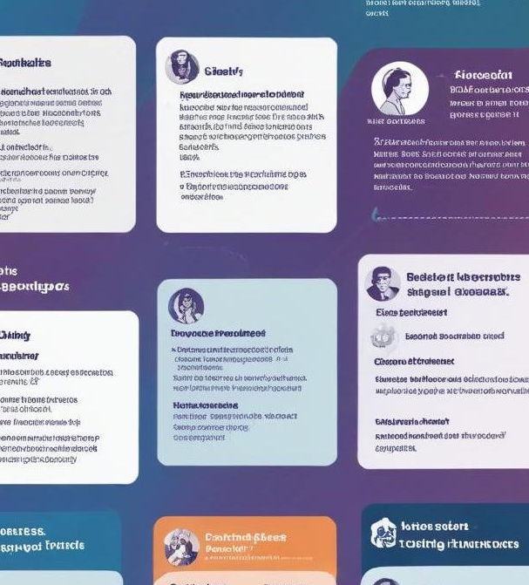
Conclusions
The Career Guide application integrates essential features and technologies that empower users in their career exploration journey, enhancing connectivity with experts and personalized support.

Slide 12
Thank you!

